Slide 1
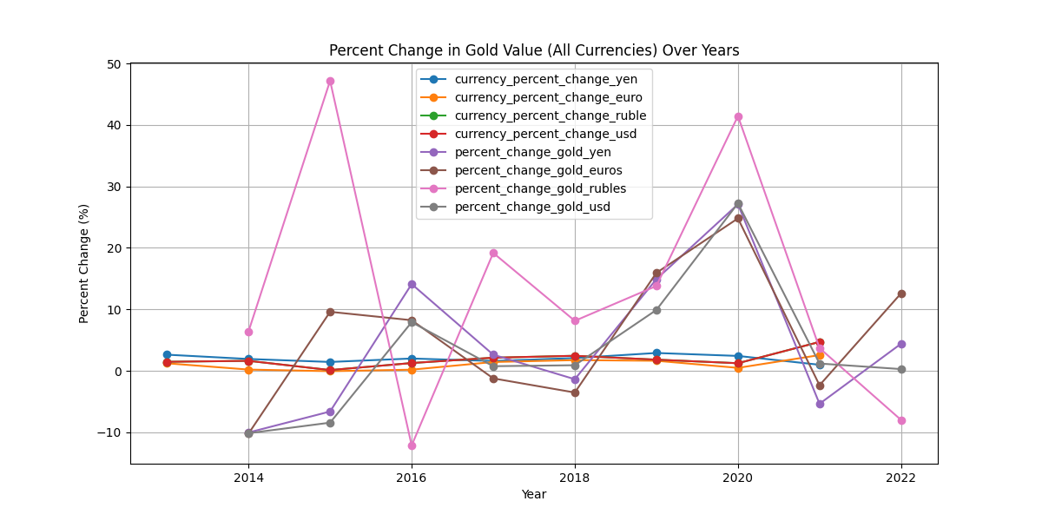
All currency inflation plotting based on percentages
Combined plotting in percentages of inflation

Slide 2
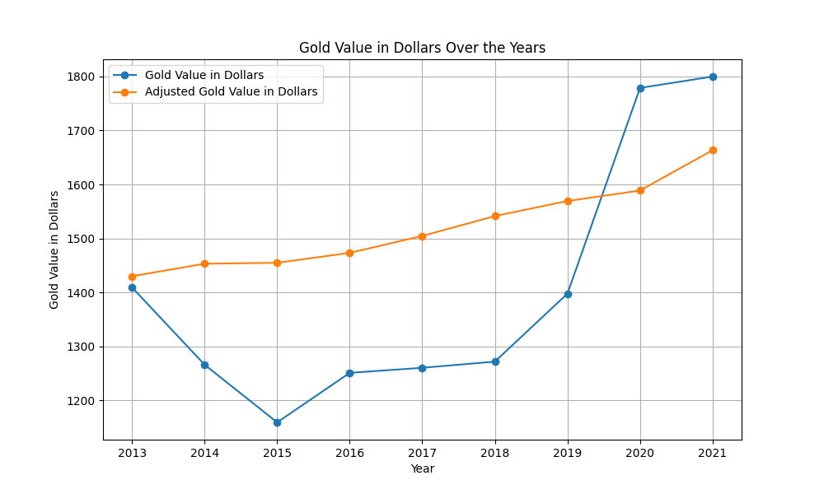
US DOLLAR
CURRENCY specific plot

Slide 3
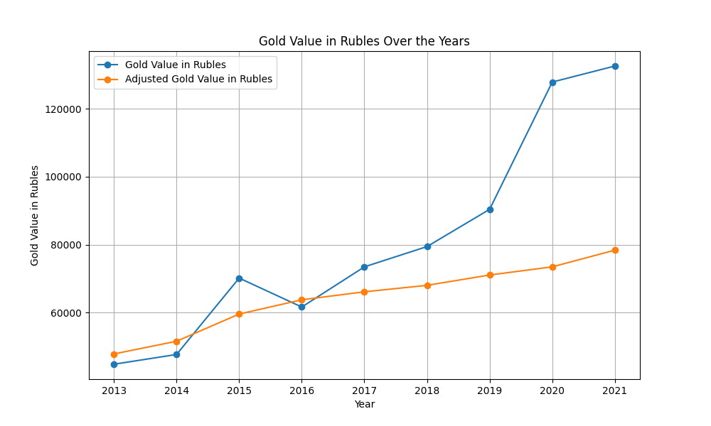
Russian ruble
CURRENCY specific plot

Slide 4
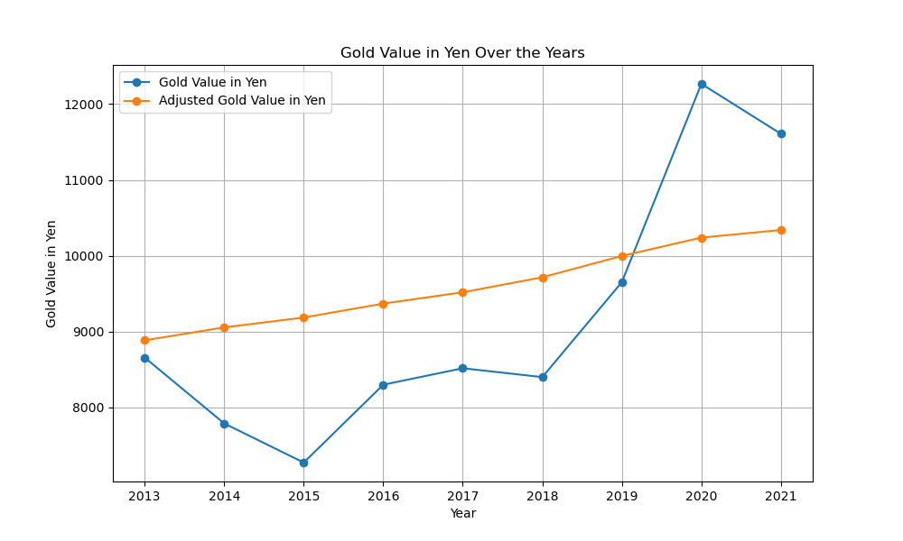
China YEN
CURRENCY specific plot

Slide 5
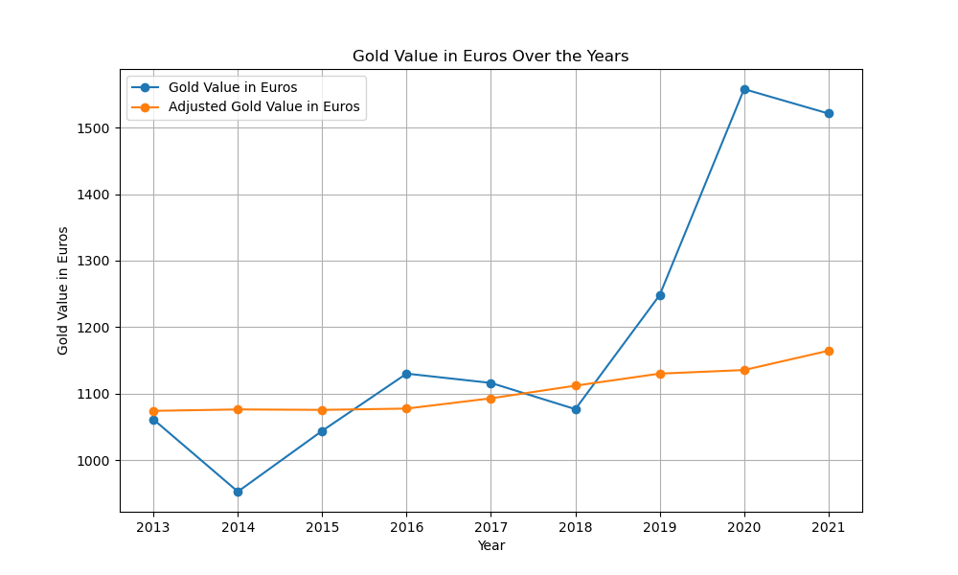
Europe EURO
CURRENCY specific plot

